Slide 1

School of Computing
Vel Tech Rangarajan Dr. Sagunthala R&D Institute of Science and Technology
Department of Computer Science and Engineering
10211CS224 / FULL STACK APPLICATION DEVELOPMENT (JAVA)
PROJECT REVIEW : MILESTONE PROJECT – 2
Date: 21-04-2026
CAMPUS EVENT MANAGEMENT
SDG 4 – Quality Education
Presented By:
J.VISHNU VARDHAN – VTU25595 – 23UECS0234
Courses Handling Faculty:
Dr.Sumithra M

Slide 2
INTRODUCTION
Background of the problem:
In many colleges, event management is handled manually through notices, spreadsheets, and paper registrations. This makes it difficult to organize events, track participants, and manage updates efficiently.
Why this project is important:
It simplifies event creation, registration, and management in one centralized system.
Real-world relevance:
Useful for colleges, universities, technical symposiums, cultural events, workshops, seminars, and hackathons.
Brief overview of the system:
The Campus Event Management System is a web-based application that allows admins to create and manage campus events, while students can view available events and register for them online.
1
2
3
4
5
6
7
8
9

Slide 3
PROBLEM STATEMENT
In many educational institutions, event registration and management are still handled manually. Students often depend on notice boards, classroom announcements, or social media updates to know about events. Organizers face difficulty in maintaining participant records, updating event details, checking capacity, and avoiding duplicate registrations. Manual handling consumes time and may lead to errors in data management. Therefore, there is a need for a secure, reliable, and automated system that can manage campus events efficiently, provide real-time access to students, and simplify registration and administration.
1
2
3
4
5
6
7
8
9

Slide 4
OBJECTIVE(S)
To design and develop a web-based Campus Event
1
Management System with student and admin functionalities.
To implement online event creation, viewing, registration, and participant management.
2
3
To reduce manual work and improve accuracy in handling
4
event-related data.
5
To provide a user-friendly interface for students and
6
administrators.
7
8
9

Slide 5
PROPOSED SYSTEM
The proposed system is a web-based Campus Event Management application.
It allows admins to add, update, and delete event details.
Students can view upcoming events and register for them easily.
The system stores all event and registration data in a database.
It reduces paperwork and manual errors.
It improves communication between event organizers and students.
It is faster, more efficient, and easier to manage than traditional methods.
1
2
3
4
5
6
7
8
9

Slide 6
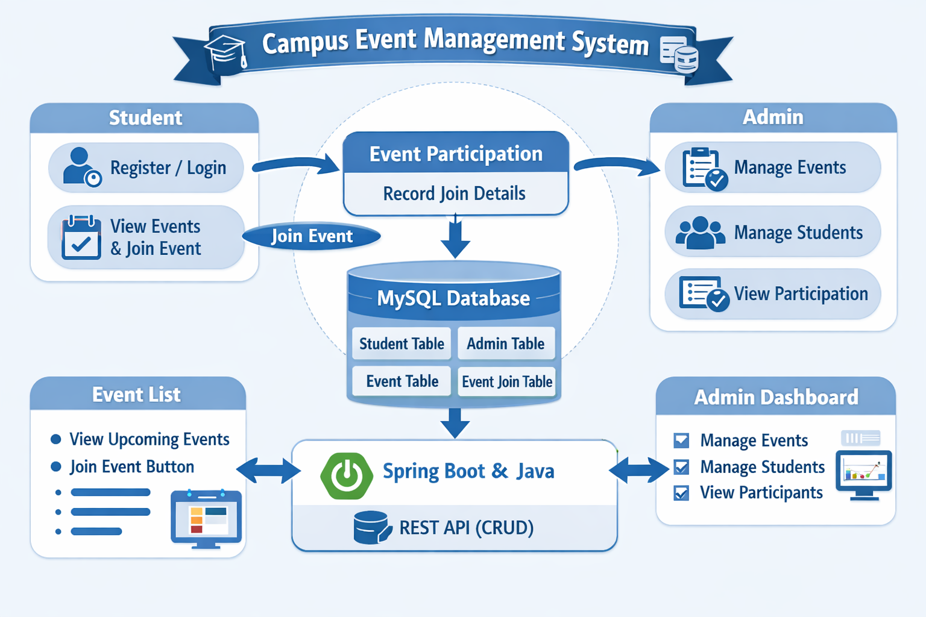
PROPOSED SYSTEM ARCHITECTURE
1
2
3
4
5
6
7
8
9

Slide 7
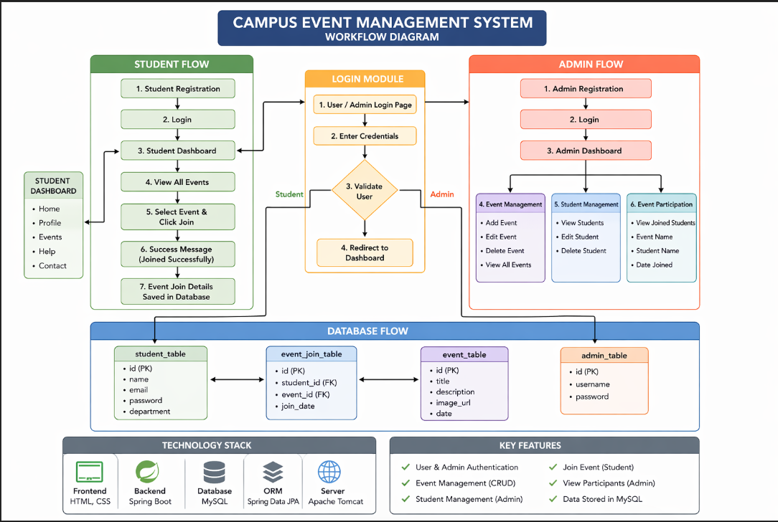
WORKFLOW
1
2
3
4
5
6
7
8
9

Slide 8
TECHNOLOGIES USED
Frontend: HTML5 , CSS3 , Bootstrap , Thymeleaf
Backend: Java , Spring Boot , Spring MVC , Spring Data JPA
Database: MySQL
Tools: Spring Initializr , Eclipse IDE , MySQL Workbench
Hardware/Software Requirements: Windows , Java 26 , Web Browser , MySQL Server
1
2
3
4
5
6
7
8
9

Slide 9
MODULE DESCRIPTION
Module 1: User Management
Handles student/admin registration, login, and profile management.
Module 2: Event Management
Allows admin to create, update, delete, and manage campus events.
Module 3: Event Viewing
Displays upcoming events with details such as title, description, date, venue, and capacity.
Module 4: Event Registration
Allows students to register for available events and stores registration details in the database.
Module 5: Participant Management
Allows admin to view registered students for each event.
1
2
3
4
5
6
7
8
9

Slide 10
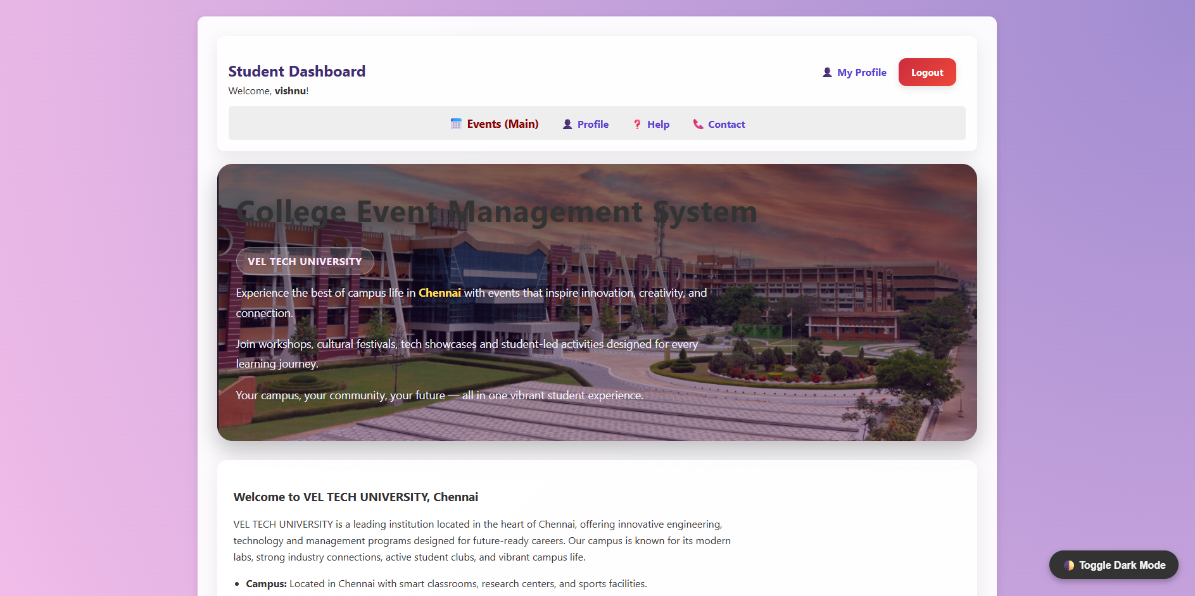
IMPLEMENTATION SCREENSHOTS
1
2
3
4
5
6
7
8
9

Slide 11
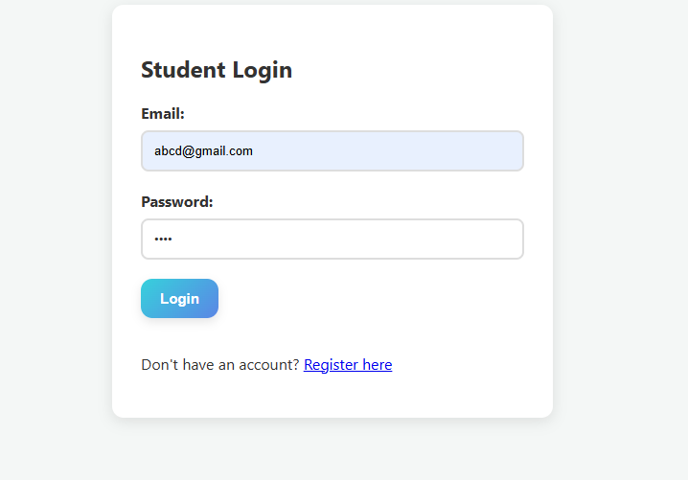
IMPLEMENTATION SCREENSHOTS
1
2
3
4
5
6
7
8(A)
9

Slide 12
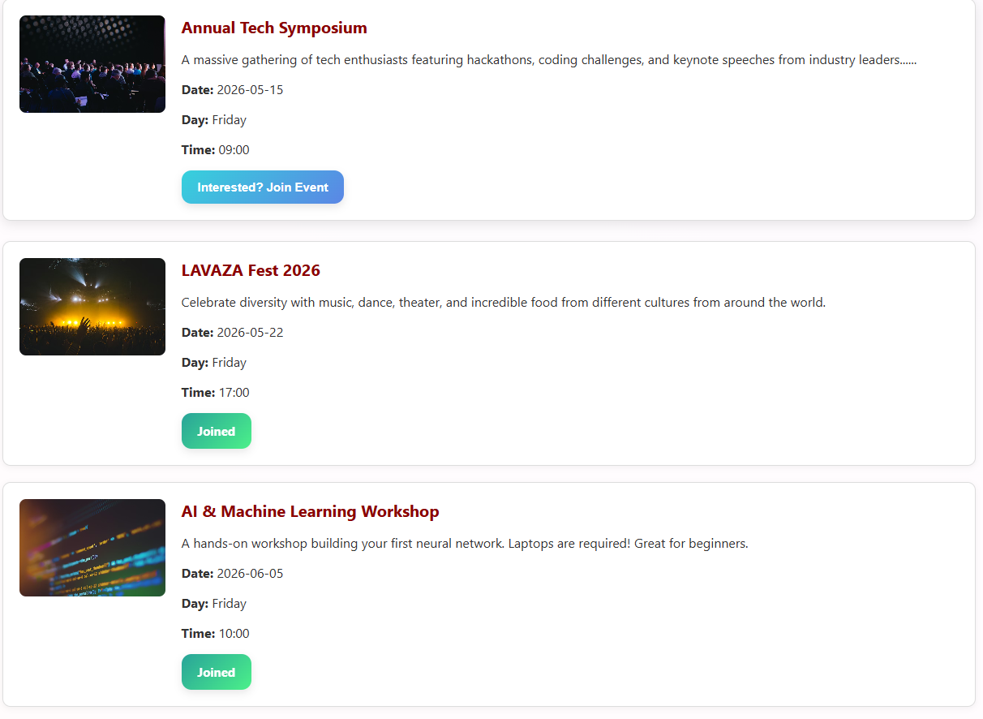
IMPLEMENTATION SCREENSHOTS
1
2
3
4
5
6
7
8(B)
9

Slide 13
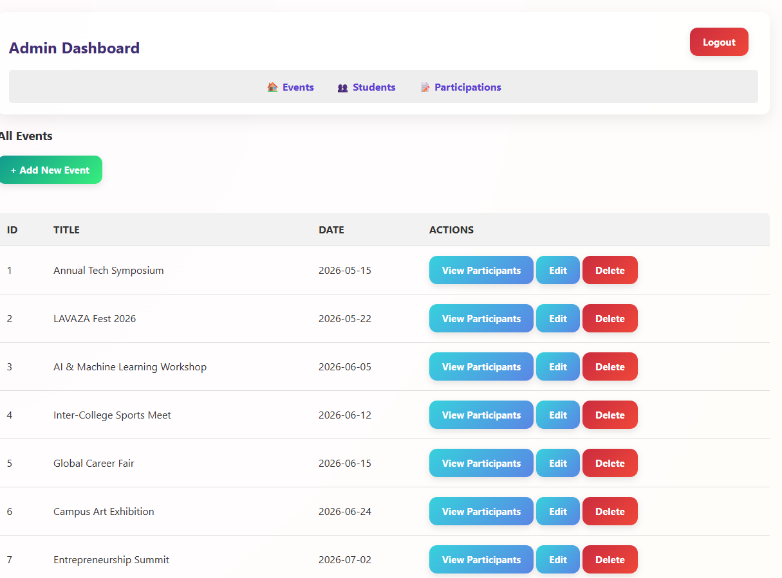
IMPLEMENTATION SCREENSHOTS
1
2
3
4
5
6
7
8(C)
9

Slide 14
ADVANTAGES & LIMITATIONS
1
ADVANTAGES
Reduces manual paperwork
Easy event creation and management
Fast and accurate student registration
Centralized database storage
Easy access for both admin and students
Scalable for multiple campus events
LIMITATIONS
Requires internet connection
Needs proper login/security for real deployment
Limited to registered users inside system
Additional features like email notifications are not included in basic version
2
3
4
5
6
7
8
9

Slide 15
Thank you

